Slide 1
Trade & Ahead
Unsupervised Learning PGP - Data Science and Business Analytics Arsalaan B. Saiyed
Date – 13th August 2022

Slide 2
Contents / Agenda
Executive Summary
Business Problem Overview and Solution Approach
Data Background and Contents
EDA Results
Data Preprocessing
Clustering
K-means Clustering
Hierarchical Clustering
Appendices
Appendix-A: EDA Results
Appendix-B: Clustering Profiles

Slide 3
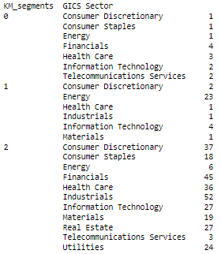
Executive Summary
Insights & Recommendations:
Based on the insights from EDA and clustering process we can provided the following insights and suggestions.
We split the 340 securities into 3 different clusters/stock buckets based on the stability of the stocks.
Cluster 1 has low volatility and stable stocks with low returns
Cluster 2 has high volatility but also chances of high returns
Cluster 3 is of medium volatility and also medium returns
Based on the clusters people can chose to pick the securities they want to invest in based on their budget and risk tolerance.

Slide 4
Business Problem Overview and Solution Approach
Problem Overview:
The stock market has consistently proven to be a good place to invest in and save for the future. It is important to maintain a diversified portfolio when investing in stocks in order to maximize earnings under any market condition. Having a diversified portfolio tends to yield higher returns and face lower risk by tempering potential losses when the market is down. It is often easy to get lost in a sea of financial metrics to analyze while determining the worth of a stock, and doing the same for a multitude of stocks to identify the right picks for an individual can be a tedious task.
Trade&Ahead is a financial consultancy firm who provide their customers with personalized investment strategies. They have provided us with data comprising stock price and some financial indicators for a few companies listed under the New York Stock Exchange. They objective is analyzing the data, grouping the stocks based on the attributes provided, and sharing insights about the characteristics of each group.
Solution Approach:
Data Overview & EDA
Data pre-processing
Applying K-means Clustering
Applying Hierarchical Clustering
Comparing K-means & Hierarchical Clustering
Executive Summary - Actionable insights and summary

Slide 5
Data Background and Contents
We have data for 340 securities listed on the New York Stock Exchange provided by Trade&Ahead
Data:
Observations | Variables
340 | 15
Variable | Description
Ticker Symbol | An abbreviation used to uniquely identify publicly traded shares of a particular stock on a particular stock market
Company | Name of the company
GICS Sector | The specific economic sector assigned to a company by the Global Industry Classification Standard (GICS) that best defines its business operations
GICS Sub Industry | The specific sub-industry group assigned to a company by the Global Industry Classification Standard (GICS) that best defines its business operations
Current Price | Current stock price in dollars
Price Change | Percentage change in the stock price in 13 weeks
ROE | A measure of financial performance calculated by dividing net income by shareholders' equity (shareholders' equity is equal to a company's assets minus its debt)
Variable | Description
Cash Ratio | The ratio of a company's total reserves of cash and cash equivalents to its total current liabilities
Net Cash Flow | The difference between a company's cash inflows and outflows (in dollars)
Net Income | Revenues minus expenses, interest, and taxes (in dollars)
Earnings Per Share | Company's net profit divided by the number of common shares it has outstanding (in dollars)
Estimated Shares Outstanding | Company's stock currently held by all its shareholders
P/E Ratio | Ratio of the company's current stock price to the earnings per share
P/B Ratio | Ratio of the company's stock price per share by its book value per share (book value of a company is the net difference between that company's total assets and total liabilities)
Volatility | Standard deviation of the stock price over the past 13 weeks

Slide 6
EDA Results
On analyzing the Univariate EDA and statistical data we have observed the following in the data:
Average current price of the securities is 80 and is slightly right skewed as the median is 59
Price change has a nominal distribution with mean of 4 and median of 4.8
Volatility is also right skewed with a mean of 1.5 and median of 1.3
ROE is heavily right skewed with large outliers and a mean of 39.6 and median of 15
Net cash flow is right skewed and has many outliers with a mean of 55,537,620 and median of 2,098,000
P/E Ratio mean is 32.6 and median is 20
P/B Ratio mean is -1.7 and median is -1.06
Link to Appendix slide on data background check

Slide 7
EDA Results
On analyzing the Bivariate EDA and statistical data we have observed the following in the data:
Healthcare has the most positive price change and Energy has the most negative price change.
Information technology, telecommunication sector and health care have the highest cash ration.
Energy has the highest P/E ratio and telecommunication sector has the lowest P/E ratio.
Energy has the highest volatility and utilities has the lowest volatility.
Link to Appendix slide on data background check

Slide 8
Data Preprocessing
Duplicate value check
Missing value treatment
Outlier check (treatment if needed)
Feature engineering
Data preparation for modeling
Note: You can use more than one slide if needed

Slide 9
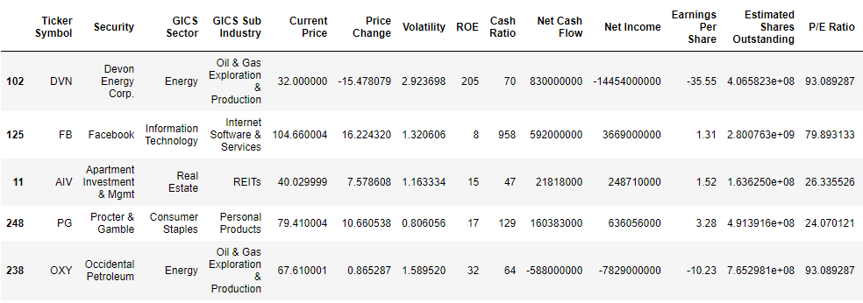

Data Preprocessing
Let’s take a quick look at a small sample of our data. This will help us get some idea of the attributes of the data and also help us understand the degree of cleaning needed before we can build a model.
Random sample of the data (340 rows, 15 columns):

Slide 10
Data Preprocessing
Duplicate Value Check: No duplicate entries were found in the given data
Missing Value Treatment: No Missing values were found in the data
Outlier Check: The are a lot of outliers but they are all real values. Therefore, there is no outlier treatment needed.
Feature Engineering: There was no need for feature engineering.

Slide 11
Clustering
Scaling
Applying K-means Clustering
Applying Hierarchical Clustering
Clustering Profiles & Comparison – K-means vs Hierarchical
Link to Appendix slide on model assumptions

Slide 12
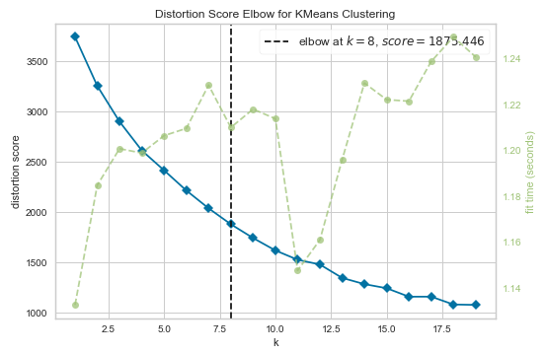
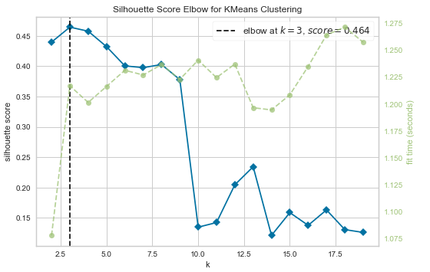
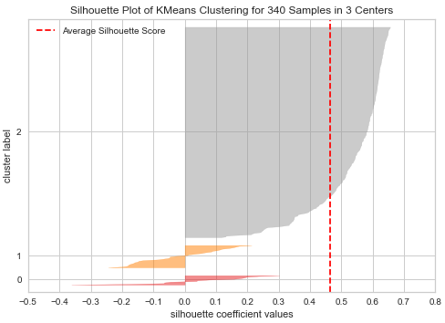
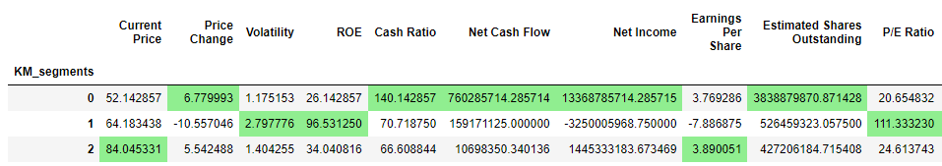
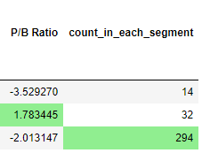
Clustering
K-Means Clustering
We select a random number of clusters and calculate the average distortion for each. Below is a elbow graph for number of clusters v/s average distortion for clusters ranging from 1 to 20. On calculating distortion the elbow falls at 8 and when silhouette scores are calculated the highest score came out to 0.464 at 3 clusters.
Then we create cluster profiles by calculating means and calculate the count of securities in each cluster.

Slide 13
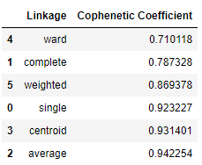
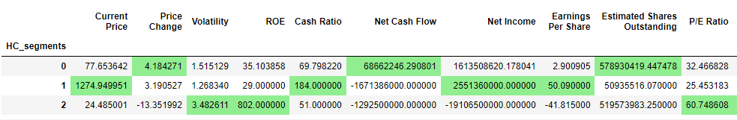
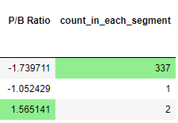
Clustering
Hierarchical Clustering
We calculated Cophenetic Coefficient using all distance metrics and all linkage methods the highest cophenetic coefficient was for Euclidean distance with average linkage between clusters of 0.942. We tried out more linkages for Euclidean distance but average linkage was the best.

Slide 14
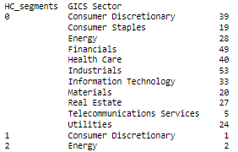
Model Performance Summary – K-means vs Hierarchical
Clustering Profiles & Comparison:
Comparing the two clustering methods K-means and Hierarchical we see that both have best silhouette scores were obtained at 3 clusters.
K-means Clustering: As we can see that cluster 1 is more stable since it has a positive price change indication, low volatility score, ROE is low but stable, high net income and high estimated shares outstanding. Cluster 2 was least stable since it has a negative price change, high volatility score, ROE is the highest and volatile, low net income and low estimated shares outstanding and cluster 3 was the much neutral compared to cluster 1&2.
Hierarchical Clustering: Here we see the cluster 1 is more stable since it has positive price change indication, low volatility score, ROE is low but stable, positive net income and high estimated shares outstanding. Cluster 3 was least stable since it has a negative price change, high volatility score, ROE is the highest and volatile, low net income and low estimated shares outstanding

Slide 15
APPENDIX A – EDA Results

Slide 16
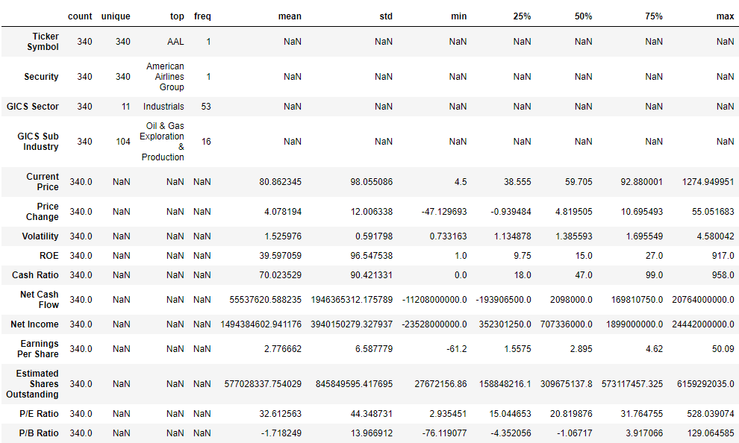
APPENDIX A: Statistical Summary

Slide 17
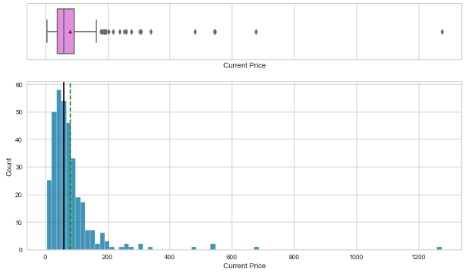
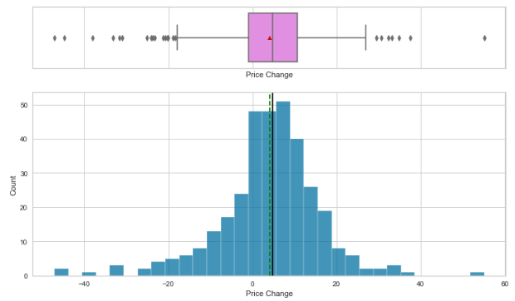
APPENDIX A: Univariate Analysis

Slide 18
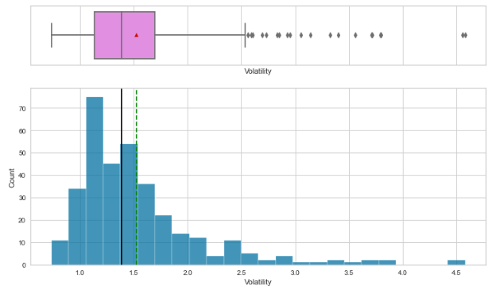
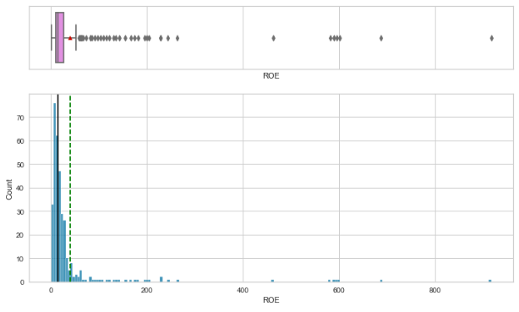
APPENDIX A: Univariate Analysis

Slide 19
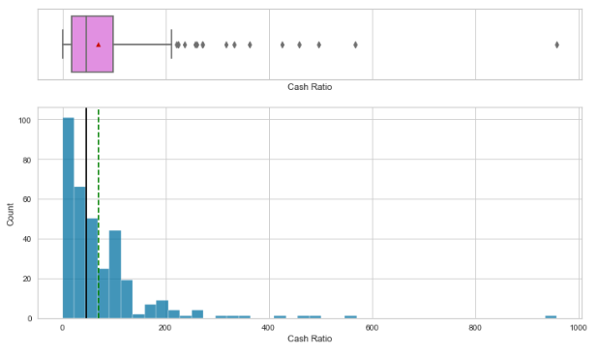
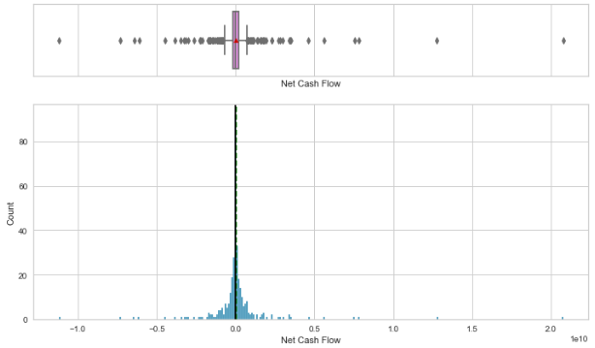
APPENDIX A: Univariate Analysis

Slide 20
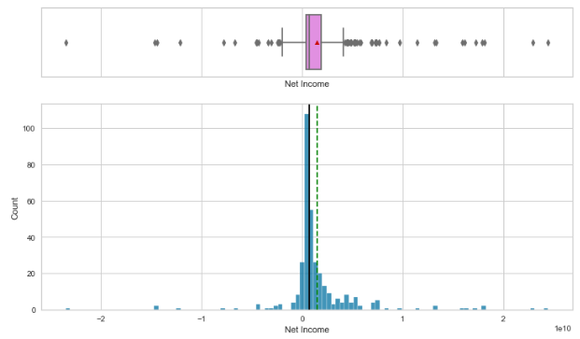
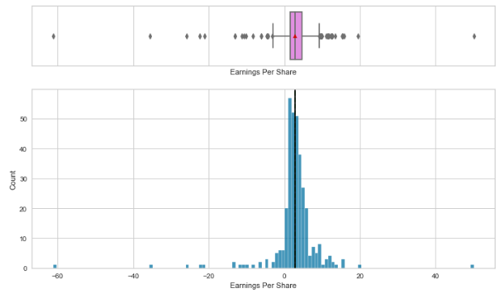
APPENDIX A: Univariate Analysis

Slide 21
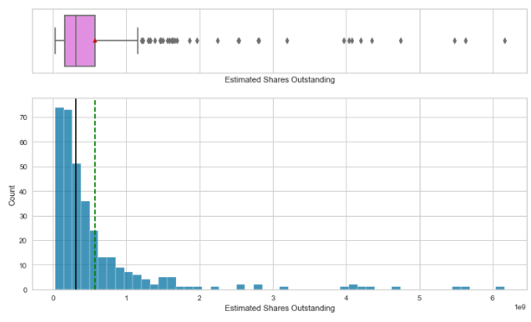
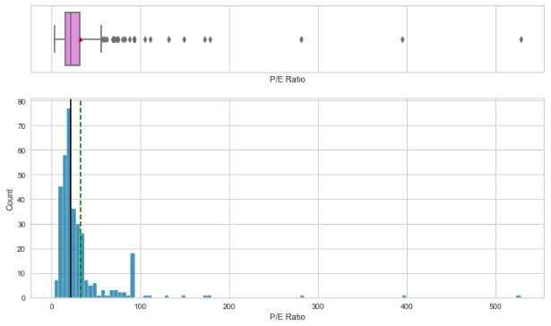
APPENDIX A: Univariate Analysis

Slide 22
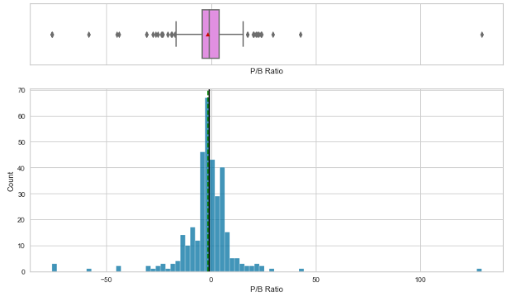
APPENDIX A: Univariate Analysis

Slide 23
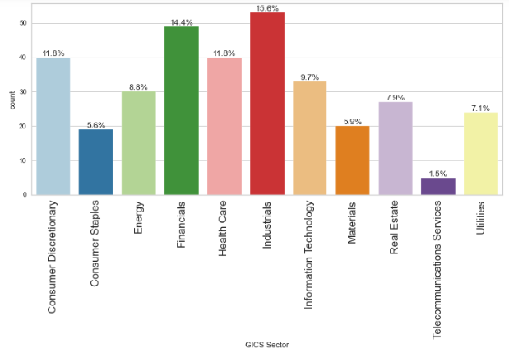
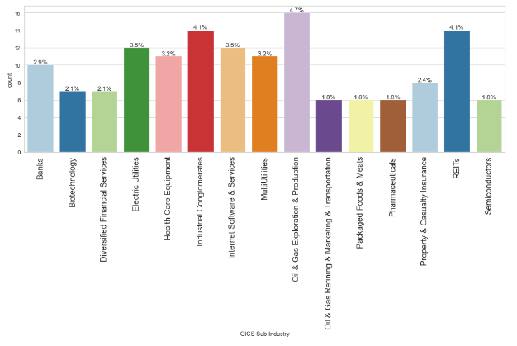
APPENDIX A: Univariate Analysis

Slide 24
APPENDIX A – EDA Results (Bivariate Analysis)

Slide 25
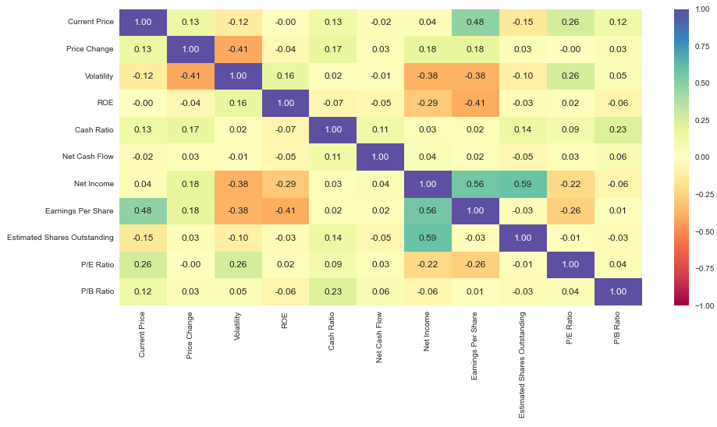
APPENDIX A: Bivariate Analysis

Slide 26
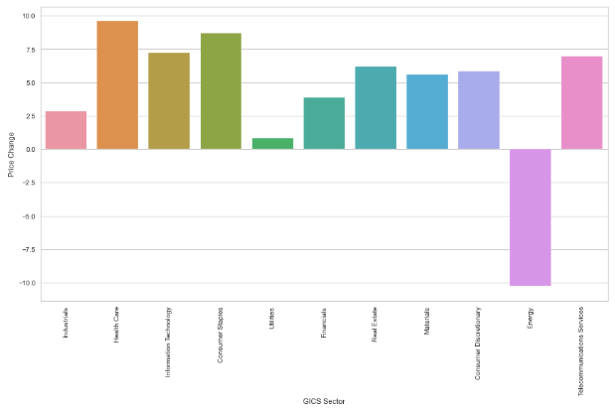
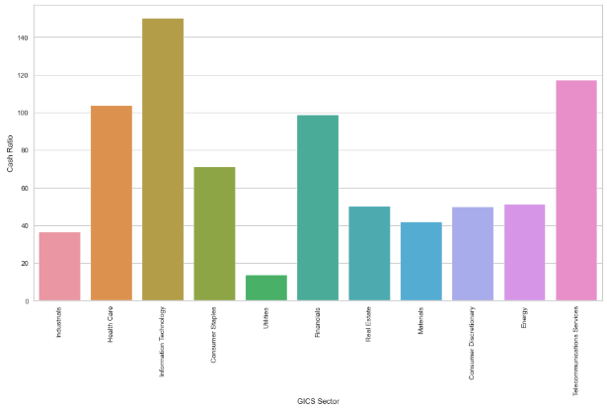
APPENDIX A: Bivariate Analysis

Slide 27
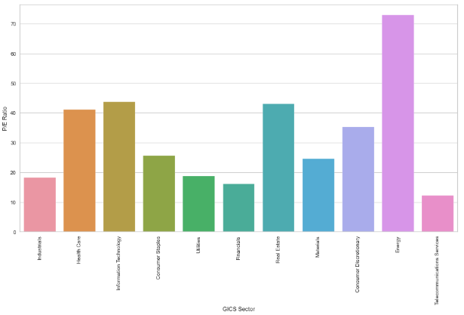
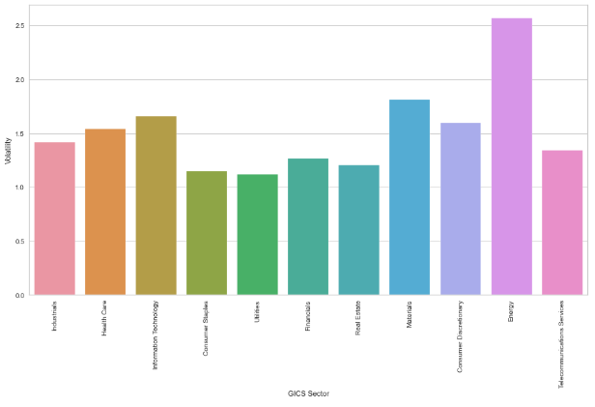
APPENDIX A: Bivariate Analysis

Slide 28
APPENDIX B – Clustering Profiles

Slide 29
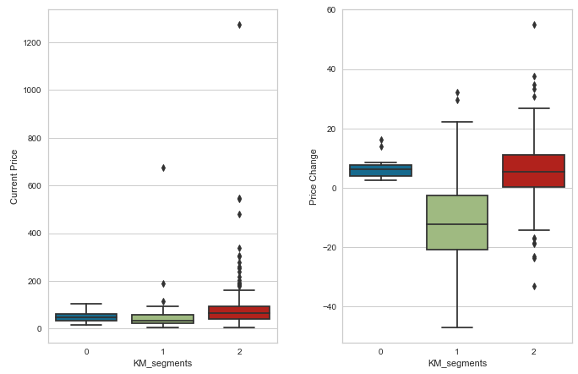
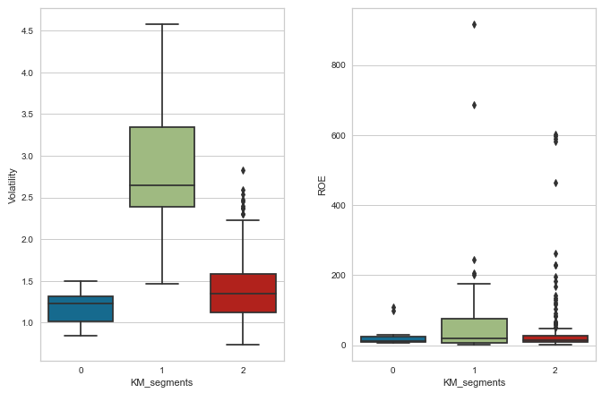
APPENDIX B: Cluster Profiles – K Means

Slide 30
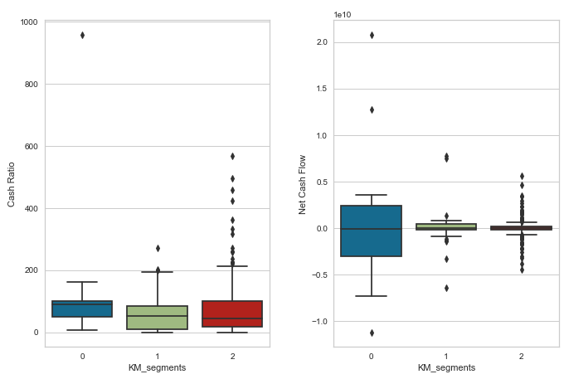
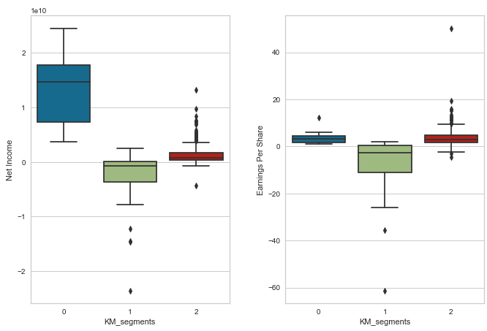
APPENDIX B: Cluster Profiles – K Means

Slide 31
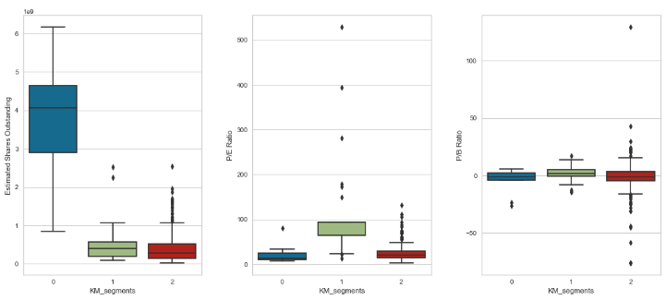
APPENDIX B: Cluster Profiles – K Means

Slide 32
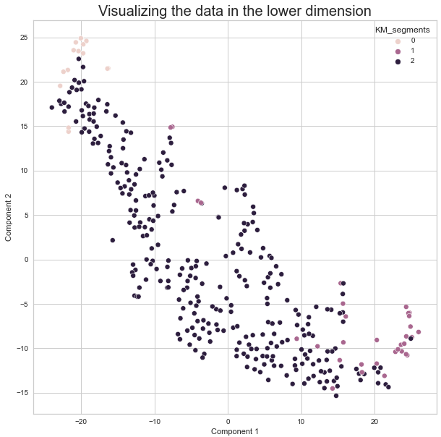
APPENDIX B: Cluster Profiles – K Means

Slide 33
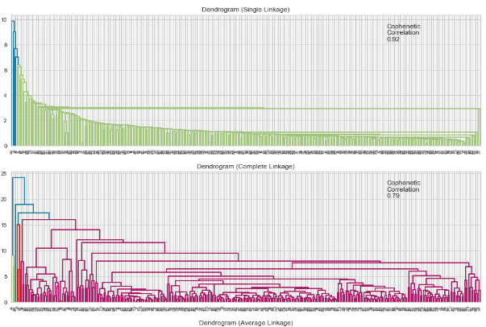
APPENDIX B: Cluster Profiles – Hierarchical Clustering

Slide 34
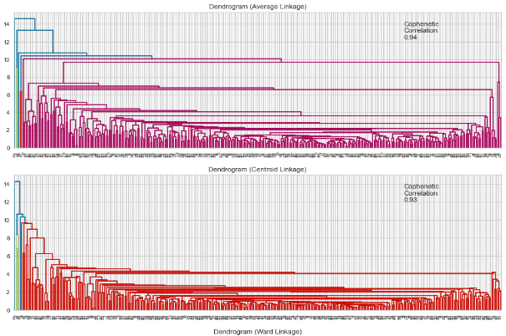
APPENDIX B: Cluster Profiles – Hierarchical Clustering

Slide 35
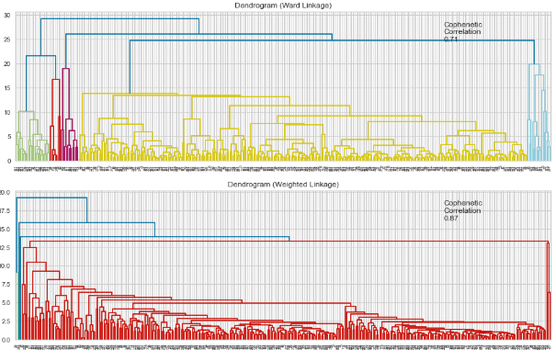
APPENDIX B: Cluster Profiles – Hierarchical Clustering

Slide 36
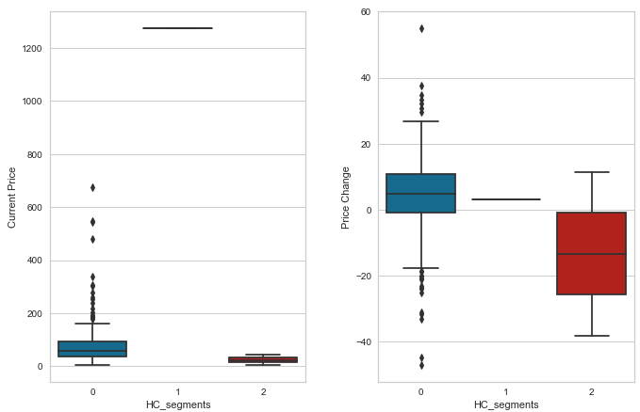
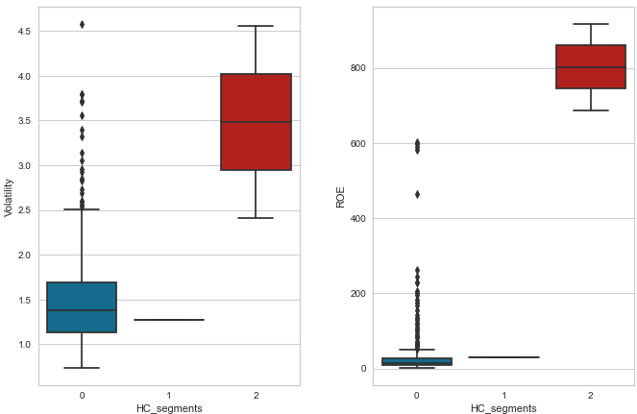
APPENDIX B: Cluster Profiles – Hierarchical Clustering

Slide 37
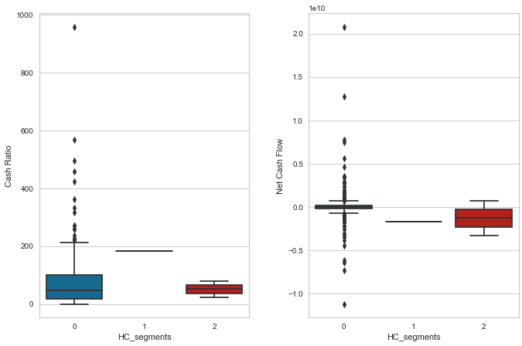
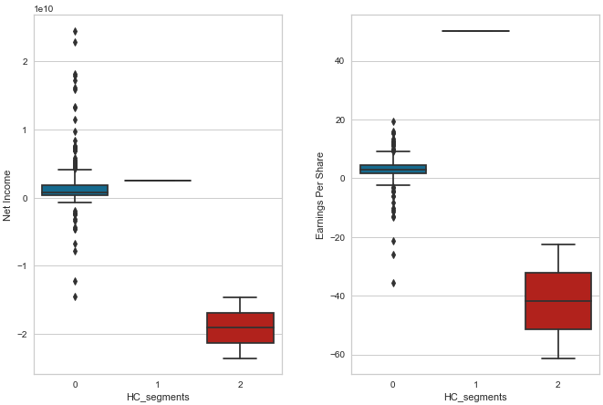
APPENDIX B: Cluster Profiles – Hierarchical Clustering

Slide 38
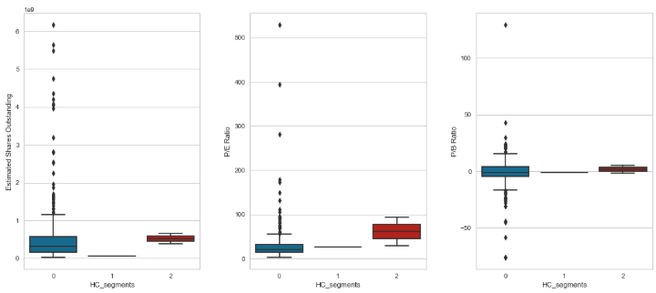
APPENDIX B: Cluster Profiles – Hierarchical Clustering

Slide 39
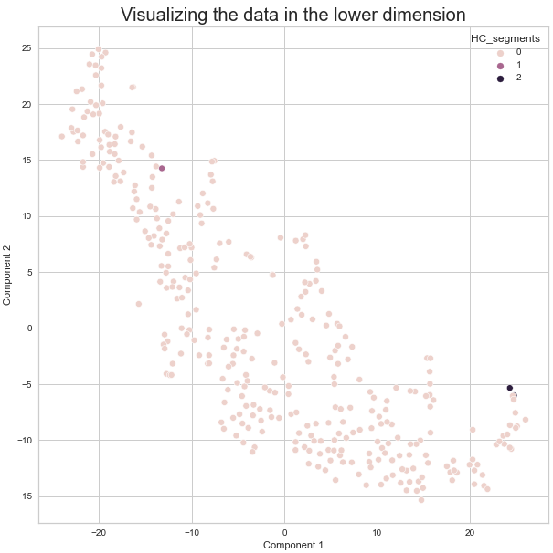
APPENDIX B: Cluster Profiles – Hierarchical Clustering

